Slide 1

The LSTM for NLP
Notes:
1

Slide 2
Objectives
Review LSTMs
Implement LSTM for classifier the IMDB dataset
The LSTM for NLP
2

Slide 3
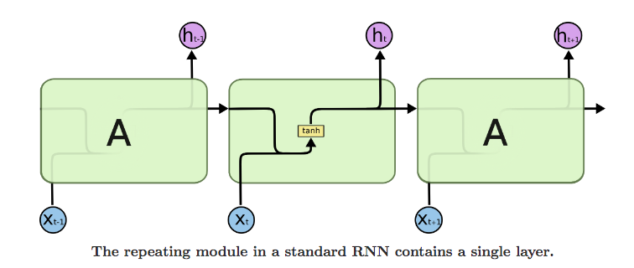
Review LSTMs
Long Short Term Memory networks are a special kind of RNN, capable of learning long-term dependencies
LSTMs are explicitly designed to avoid the long-term dependency problem.
All recurrent neural networks have the form of a chain of repeating modules of neural network.
The LSTM for NLP
3
Notes:
3

Slide 4
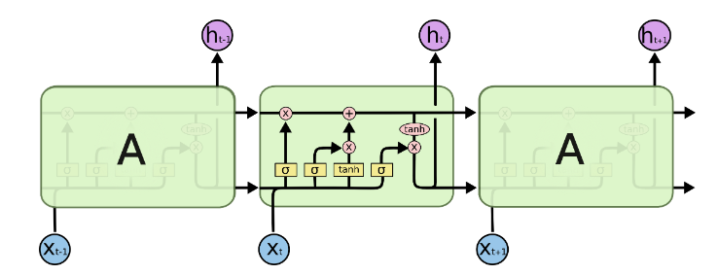
Review LSTMs
LSTMs also have the chain of repeating modules of neural network, but the repeating module has a different structure. Instead of having a single neural network layer, there are four, interacting in a very special way.
The LSTM for NLP
4
Notes:
4

Slide 5
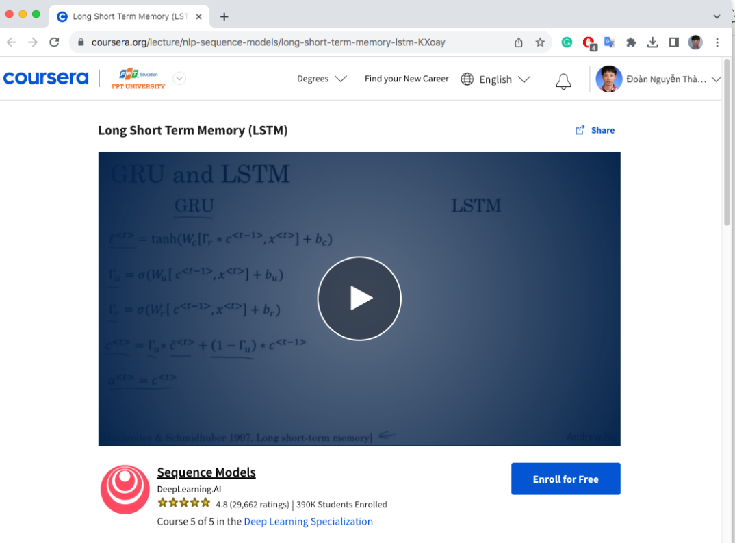
Review LSTMs
More information on LSTMs (Long Short Term Memory cells)
https://www.coursera.org/lecture/nlp-sequence-models/long-short-term-memory-lstm-KXoay
The LSTM for NLP
5
Notes:
5

Slide 6
LSTMs in TensorFlow for NLP
Build a model with multiple LSTM layers for classify
Dataset: IMDB review/subwork8k
The LSTM for NLP
6

Slide 7
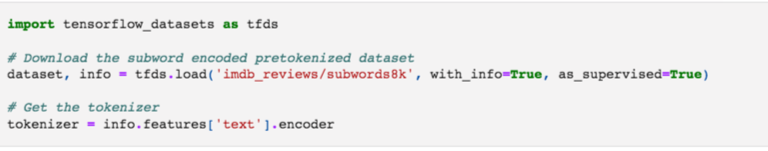
Download the Dataset
The LSTM for NLP
7

Slide 8
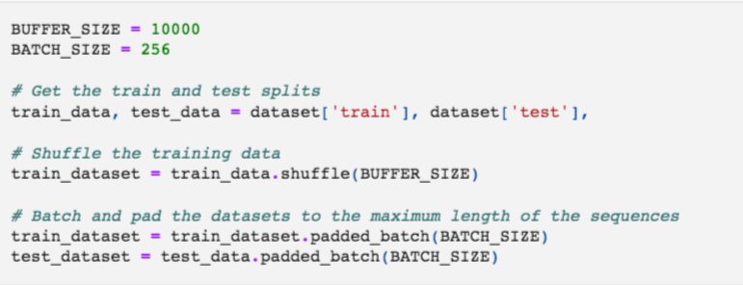
Prepare the Dataset
The LSTM for NLP
8

Slide 9
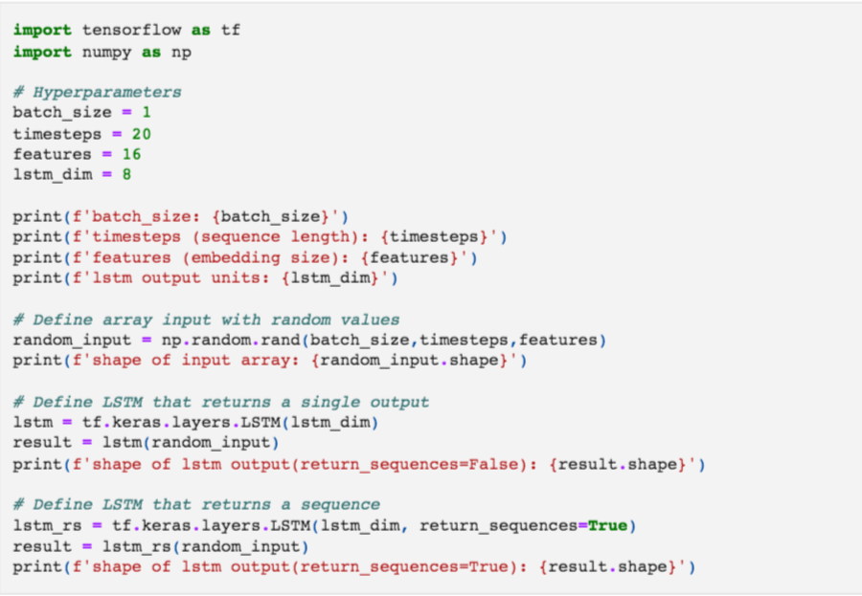
Setup Hyperparameters
The LSTM for NLP
9

Slide 10
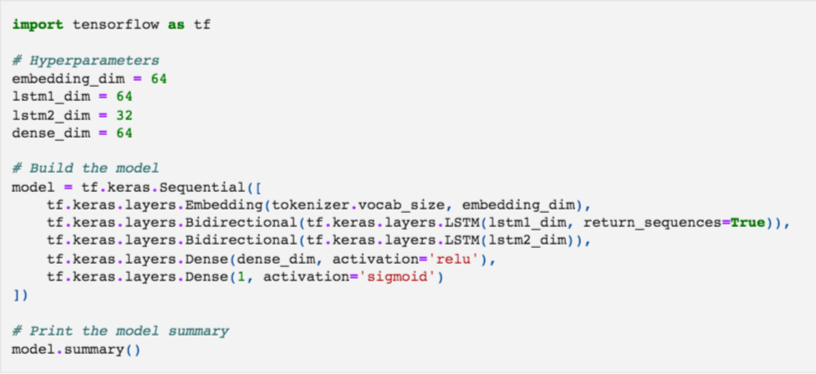
Build model
The LSTM for NLP
10

Slide 11
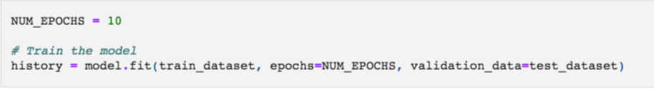
Compile and train model
The LSTM for NLP
11

Slide 12
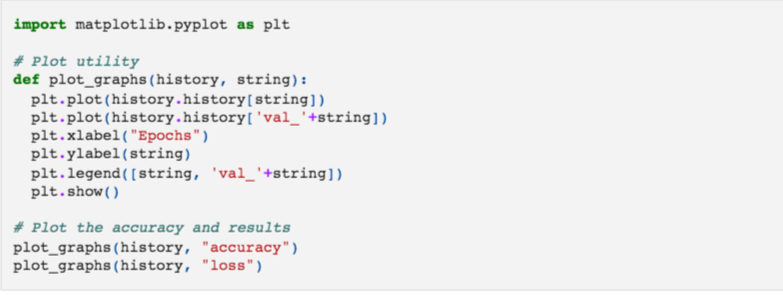
The results
The LSTM for NLP
12

Slide 13
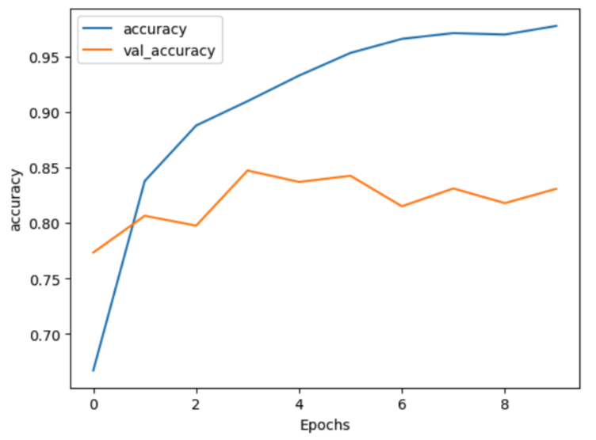
The results
Discuss and give opinions
The LSTM for NLP
13
Notes:
overfiting

Slide 14
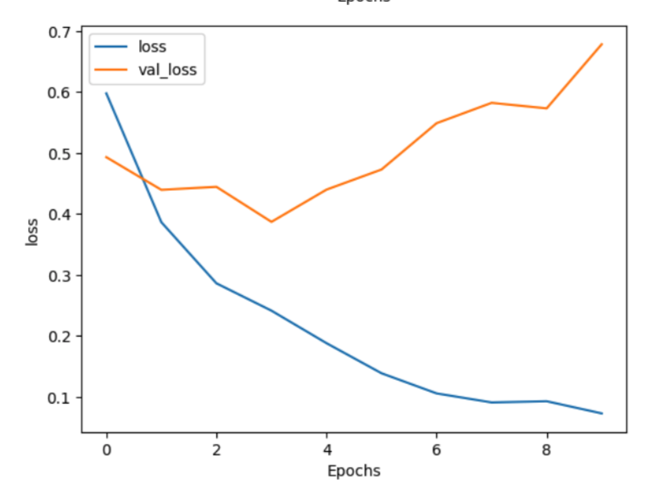
The results
Discuss and give opinions
The LSTM for NLP
14
Notes:
overfiting

Slide 15
Summary
Review LSTMs
Implement LSTM for classifier the IMDB dataset
The LSTM for NLP
15

Slide 16
Q & A
The LSTM for NLP
16

